Slide 1



Practical AI for Power BI Developers
Andrew Boerger

Slide 2







Slide 3


Bio
Andrew Boerger
Analytics Manager
AGC Automotive North America
Live & work in Bellefontaine, Ohio
LinkedIn | Reddit | aboerg.dev

Slide 4
Bio 2
Just a user
Fabric Analytics Engineer Associate (DP-600)
Fabric Data Engineer Associate (DP-700)
HackTogether: The Microsoft Fabric Global AI Hack
Best use of Copilot for Microsoft Fabric: Accounts Payable Payment Prediction
Administering Power BI Premium since 2020
Using Fabric since day 1 of Public Preview

Slide 5

My organization
5
World leader in automotive glass
North American business unit (~3K employees)
Using Power BI (2018), Premium (2020), Synapse (2021), Fabric (2023)

Slide 6
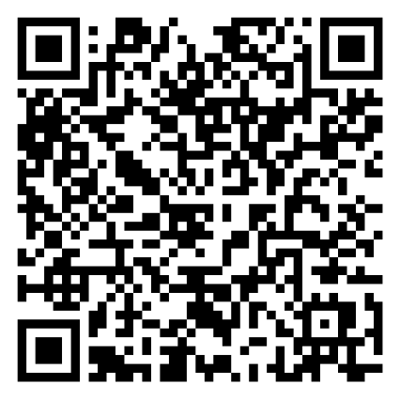
Repo

Slide 7
I'm not an “AI expert.”
I’m just trying to keep up.

Slide 8
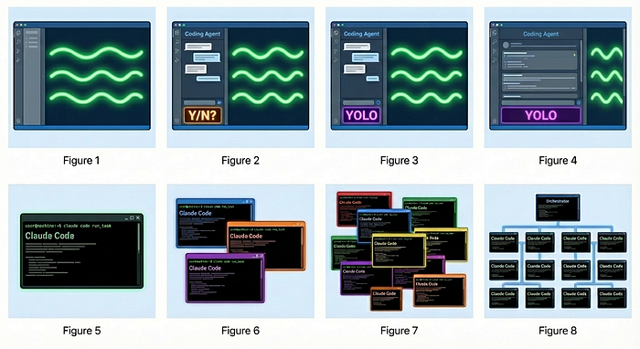
Stage 1: Zero or Near-Zero AI: maybe code completions, sometimes ask Chat questions
Stage 2: Coding agent in IDE, permissions turned on. A narrow coding agent in a sidebar asks your permission to run tools.
Stage 3: Agent in IDE, YOLO mode: Trust goes up. You turn off permissions, agent gets wider.
Stage 4: In IDE, wide agent: Your agent gradually grows to fill the screen. Code is just for diffs.
Stage 5: CLI, single agent. YOLO. Diffs scroll by. You may or may not look at them.
Stage 6: CLI, multi-agent, YOLO. You regularly use 3 to 5 parallel instances. You are very fast.
Stage 7: 10+ agents, hand-managed. You are starting to push the limits of hand-management.
Stage 8: Building your own orchestrator. You are on the frontier, automating your workflow.
Welcome to Gas Town | by Steve Yegge | Medium

Slide 9
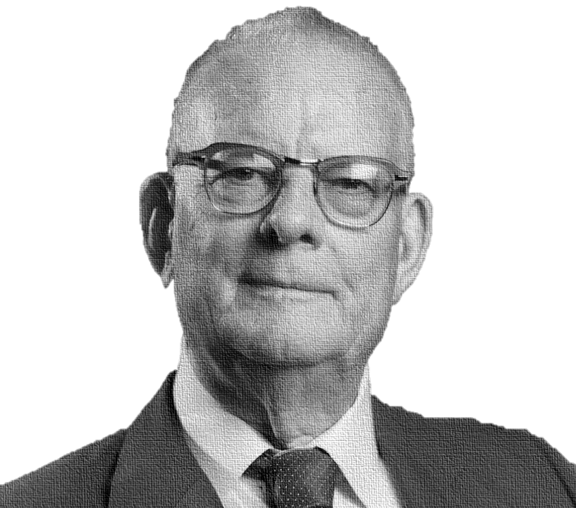
“Experience teaches nothing. In fact, there is no experience to record without theory… Without theory there is no learning… People copy examples and then they wonder what is the trouble. They look at examples and without theory they learn nothing.”
- W. Edwards Deming
Theory
Practice
Notes:
You’ve all fallen into a trap. This is a history talk disguised as a technology talk. I’m only half kidding.
In keeping with this theme, this is going to be a two-part talk. We’re going to dive into history and theory of quality and then finish up with practical implementations of data quality principles using Fabric.
Let’s go on a journey to implement a total quality management system in Microsoft Fabric

Slide 10
Part 1: Practical AI…
Part 2: …For Power BI developers
Part 3: Demos!

Slide 11
Goal: If nothing else, you leave with a few useful tips, resources, and ideas

Slide 12

Part 1:
Practical AI
https://bbycroft.net/llm

Slide 13
Large language models predict the next token.
Wait…what’s a token?

Slide 14
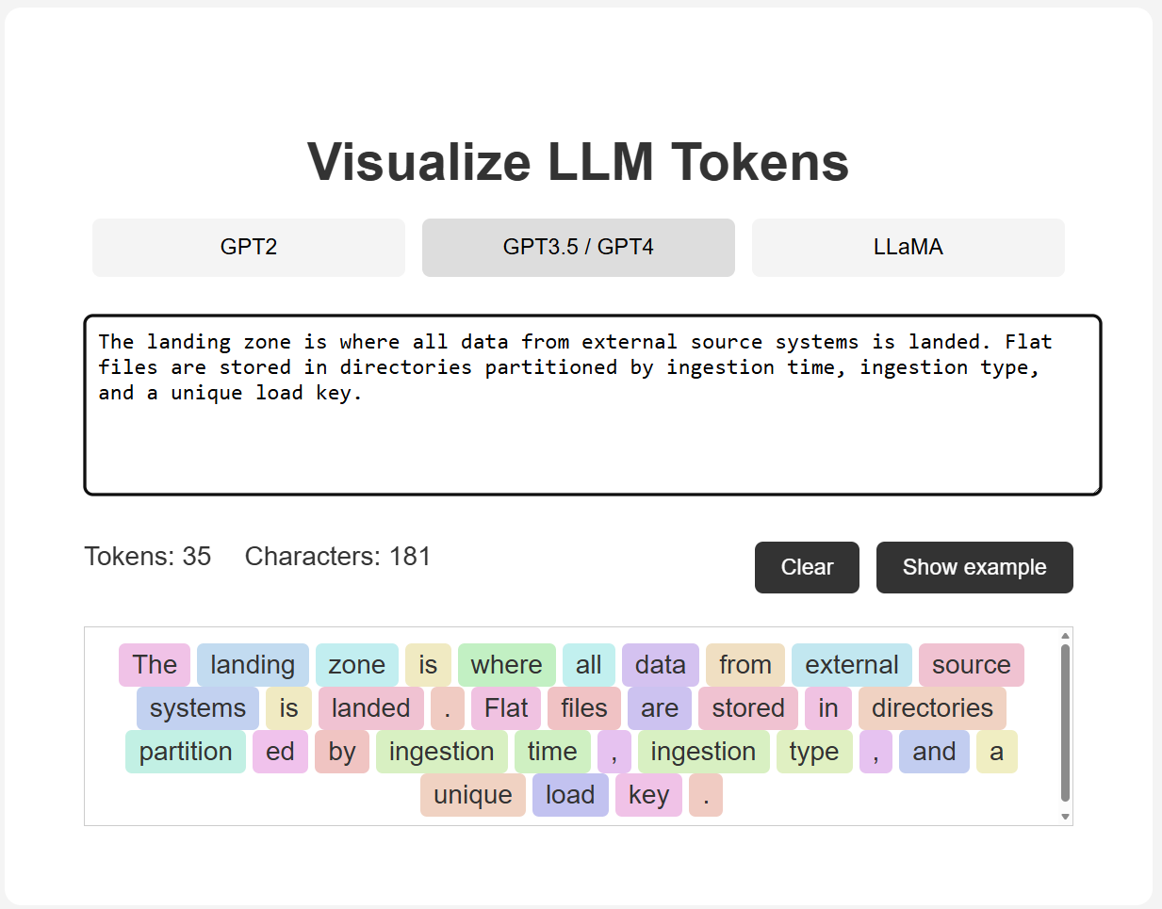
Visualize it → tokenvisualizer.netlify.app
Notes:
Generally input tokens are more expensive than output tokens

Slide 15
The context window
INPUT
LLM
OUTPUT
The
cat
sat
on
the
mat
.
A
cat
is...
predicts next token
Every input + output is tokenized first. 1 token ≈ ¾ of a word.
Context window = model's short-term memory (measured in tokens)
FRONTIER MODELS
CHEAPER, FASTER MODELS
200K – 1M+
128K – 200K
tokens (e.g., GPT-5.5, Claude Sonnet 4.6, Gemini 3.1)
tokens (e.g., GPT-5 mini, Claude Haiku, Gemini Flash)

Slide 16
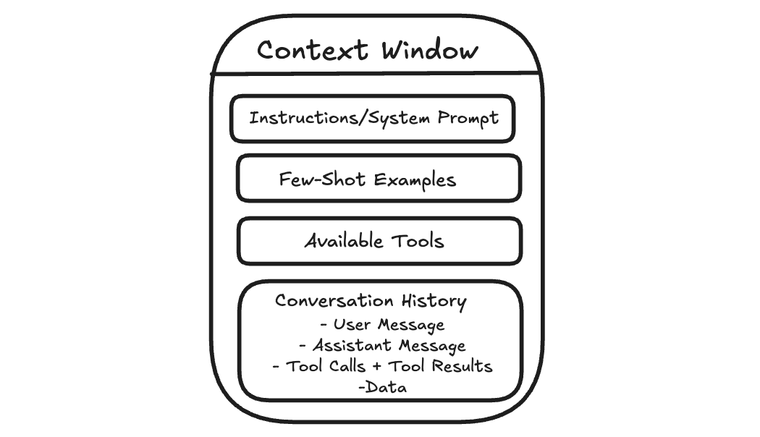
The context window
No persistent state between chats
“Context” is the entire chat transcript replayed
Context window is finite
There is no memory. Anything it knows about you, your repo, or your model lives in the context window. Context should live in a file you control: AGENTS.md, a skill, the PBIP repo. Not in conversation history.

Slide 17
Agent “memory”
STEP 1
STEP 2
STEP 3
STEP 4
You start a new chat
System searches saved “memories”
“Memories” inserted into context
Model sees expanded context
Fresh conversation, no history visible to you.
Looks for relevant snippets from past conversations.
These are already included before or with your first message.
Responds as if it "remembers" — it's just reading text.
DO INSTEAD
Put it in your project
Model conventions, BPA rules, refresh procedures belong in AGENTS.md, documentation, or skills, not in vendor-managed "memory."

Slide 18
The system prompt
ANATOMY OF A SYSTEM PROMPT
WHY IT MATTERS
ALWAYS-ON
PERSONA
You don't see it, but it's always there.
You are Claude, a helpful AI...
Sometimes thousands of tokens of context loaded before your first message even arrives.
TOOLS
<bash>, <file_read>, <web_search>...
INVISIBLE INFLUENCE
SAFETY RULES
It shapes every response.
Refuse harmful requests, cite sources
Persona, tools, safety, formatting, defaults — all set before the model considers your question.
FORMATTING
Use markdown
THE TAKEAWAY
You don’t talk to the raw model.
DEFAULT BEHAVIOR
Ask clarifying questions, be concise
The harness shapes everything. Treat the system prompt as part of the product.

Slide 19
Prompt to context engineering
PROMPT ENGINEERING
CONTEXT ENGINEERING
“You are a senior engineer who…”
Get the right information into the context window.
Not as relevant in 2026. Models already know how to be helpful.
Coding standards, project layout, prior decisions, examples.
Get them out of your head, into files the agent can read.

Slide 20
Markdown
WHY MARKDOWN?
01
Models speak text.
Almost every agent-readable file in your project is .md
# Project setup
## Build commands
02
- `npm run build` — production bundle
READMEs, agent instructions, skills, prompts … most assume markdown
- `npm test` — run unit tests
## Things never to touch
- `/legacy/` — do not modify
- generated `*.tmdl` files
03
Diff-friendly, human-friendly, model-friendly
Clean, structured, plain text.
You will write a lot of it.

Slide 21
AGENTS.md | CLAUDE.md | copilot-instructions.md
THE SHIFT
README.md is for humans. AGENTS.md is for the AI.
WHAT IT IS
WHAT GOES IN IT
WHO READS IT
A markdown file at the project root
Conventions and guardrails
Every major agent
Tells the agent how to behave in your Power BI repo — the same way you'd brief a new analyst joining the team.
PBIP project layout, TMDL naming conventions, BPA rule sets, and the measures never to touch.
AGENTS.md is an open standard. CLAUDE.md and copilot-instructions.md are tool-specific equivalents.
IF YOU DO ONE THING FROM THIS TALK
Add an AGENTS.md to your project today.

Slide 22
Layered context
GLOBAL
PROJECT
LOCAL
~/.claude/CLAUDE.md
AGENTS.md
.local files
Your personal preferences
Team standards
Personal sandbox
Applies to every Power BI project you touch. "Always write DAX with explicit table prefixes." "Use kebab-case for TMDL filenames."
Committed alongside your PBIP. Every analyst — and every agent — reads the same model conventions.
Gitignored. Path overrides, machine-specific tweaks that don't belong in the shared repo.
PRECEDENCE
NOTHING NEW HERE
Team standards beat personal preferences
Same pattern as .gitignore and other “layered” configs
Agent reads all three, but project rules override your globals.

Slide 23
Skills
ANATOMY OF A SKILL
WHAT'S IN A SKILL.MD?
bpa-rules/
├── SKILL.md
│ title + description load eagerly
│ full body loads when relevant
├── bpa-syntax.md
├── rule-examples/
└── te-cli/
"When asked to author a BPA rule, follow these steps. Here are the rules. Here are examples."
Skills are “SOPs” for AI agents. Think of them as the same kind of documentation and playbooks you'd hand a new hire on day one.
Progressive disclosure
Open format
Read the skill files!
Title and description sit in the agent's context. The full body only loads when the task matches.
Anthropic published the spec. Claude, Cursor, and most coding agents now support skills.
Other people's skills double as well-edited guides for how a task should actually be done.

Slide 24
MCP: Model Context Protocol
AN OPEN STANDARD FROM ANTHROPIC, LATE 2024
HOW IT WORKS
THE PROBLEM IT SOLVES
Replaces a thousand custom integrations
tabular-editor
pbi-desktop
One client-server model instead of glue code for every tool.
MCP SERVERS PROVIDE “TOOLS” FOR AGENTS
AGENT
Apply BPA. Read TMDL. Refresh a model.
AGENT
Power BI capabilities surfaced to the agent over one simple, text-based interface.
pbip
fabric-cli
WHY IT MATTERS
Agents discover tools without code
tabular-editor, pbi-desktop, fabric-cli, pbip.
MCP was intended as the “USB” for AI, avoiding many custom point-to-point integrations

Slide 25
MCP vs Skills
TWO WAYS TO TEACH YOUR AGENT
MCP
SKILLS
Live tools, runtime calls
Markdown SOPs, static files
Can invoke a running service
Always loaded in context window
Needs an MCP server running locally or remote
Example: pbi-desktop can query your local model
Instructions and resources in simple markdown + files
Progressive disclosure, load only what’s needed
Just files in a folder
Example: bpa-rules/ teaches BPA syntax
WHERE MCP HURTS
Token bloat
Every tool description sits in context, even unused ones. A big MCP server can eat thousands of tokens before you’ve done anything.

Slide 26
Hooks
AUTOMATIC VALIDATION AFTER EVERY EDIT — TIGHTENS THE FEEDBACK LOOP
THE FEEDBACK LOOP
WHY IT MATTERS
Instant feedback on validity
1
Agent edits TMDL file
No more "that should work" guesses — the agent sees pass/fail before it moves on.
model.tmdl
2
Hook fires automatically
WHEN IT'S CRITICAL
PostToolUse
Newer or niche tools
TMDL, Bicep, custom DSLs — anything the model hasn't seen much in training.
3
Validator runs
tmdl-validate ./model.tmdl
THE EFFECT
4
Result fed back to agent
Fewer "actually that didn't work" rounds
✓ valid | ✗ line 42: syntax error
The agent self-corrects in one shot instead of three. Real time saved.
Hooks are deterministic scripts that automatically at in a specific point in the AI’s workflow

Slide 27
Plugins
ONE INSTALL = A WHOLE DOMAIN OF EXPERTISE
ONE PLUGIN BUNDLES…
Install one thing
Skills
The agent gains a whole domain of expertise without installing individual components.
Markdown SOPs the agent reads
MCP servers
Tool integrations for external APIs
Portable standard: Claude Code, Codex, Copilot CLI
Hooks
All three CLIs support the same plugin pattern. Write once, run across.
Validators run after edits
Commands
Slash-prefixed shortcuts
Easy sharing
Sub-agents
Specialized helpers it can spawn
Install many skills, subagents, hooks, and MCPs at once with plugins

Slide 28
Part 2:
For Power BI developers

Slide 29
Power BI Project (PBIP) format
OLD
NEW
.pbix
.pbip
Zipped binary format. Not friendly to source control, diffs, merges, etc.
Report and model as text files: TMDL, PBIR JSON. Designed for source control. Pairs with Fabric Git integration.
Without Git, you can’t collaborate effectively with your coworkers OR agents.

Slide 30
Fabric workspaces + Git integration
WORKSPACE ↔ REPO
VERSIONED CODE
Two-way Git sync
Lakehouse + pipelines + notebooks
Connect a workspace to an Azure DevOps or GitHub branch. Changes flow both ways.
All become reviewable, diffable artifacts under source control.
WITH PBIP
WHY IT MATTERS
End-to-end source control
The substrate for agents
Reports, semantic models, and data items in one Git-tracked solution.
Without this, agents have nothing to read, write, or review against.

Slide 31
data-goblin / power-bi-agentic-development
A PLUGIN MARKETPLACE FOR POWER BI WORK — OPEN SOURCE, GPL-3.0
tabular-editor
pbip
Tabular Editor expert
TMDL & PBIP authoring
BPA rules, C# scripting (TOM, LINQ), macros, CLI invocation, TE3 config, doc search.
Edit semantic models as code — TMDL syntax, PBIP project structure, conventions.
pbi-desktop
fabric-cli-plugin
Connect to Desktop's local AS
Fabric workspace operations
Talks to the local Analysis Services instance via TOM and ADOMD.NET.
Separate plugin for everything that lives in Fabric — workspaces, items, deployment.
INSTALL IN
Claude Code · Codex · Gemini CLI · GitHub Copilot

Slide 32
Other useful plugins, skills
microsoft/hve-core: A refined collection of Hypervelocity Engineering components (instructions, prompts, agents, and skills)
skills/skills/productivity/grill-me/SKILL.md at main · mattpocock/skills
microsoft/skills-for-fabric: A collection of skills and MCP systems to enable users of CLI, VSCode, Claude to operate over Microsoft Fabric
Always read skills before installing!

Slide 33
PQL.Assert: DAX unit testing for semantic models
github.com/clientfirsttech/PQL.Assert
EXAMPLE · TotalSales.dev.test.dax
NAMING CONVENTION
[name].[env].test(s)
// Test: TotalSales returns expected value for FY2024
EVALUATE PQL_Assert.Equals(
[Total Sales (FY24)], // actual
12500000, // expected
"TotalSales.FY24" // test name
)
// → returns Pass / Fail row
// → CI pipeline fails on any test failure
DEV, TEST, PROD, or ANY. Pipeline picks tests by environment automatically.
DELIVERY
Native DAX, MIT licensed
Drops into any semantic model. Tests live alongside measures in TMDL.
AUTHORING
Custom Copilot agent
"Power BI Semantic Model Test Specialist" generates tests from plain English.
TAKEAWAY
Create unit tests in your semantic models. Run them locally, or remotely with a simple EVALUATE call.

Slide 34
Part 3:
Demos!

Slide 35
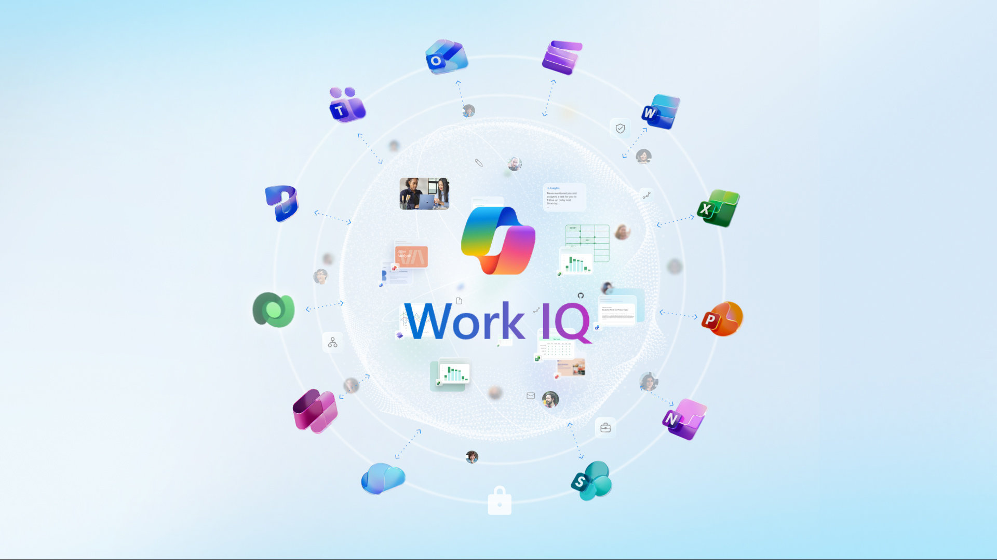
Work IQ & Wiki as Code

Slide 36
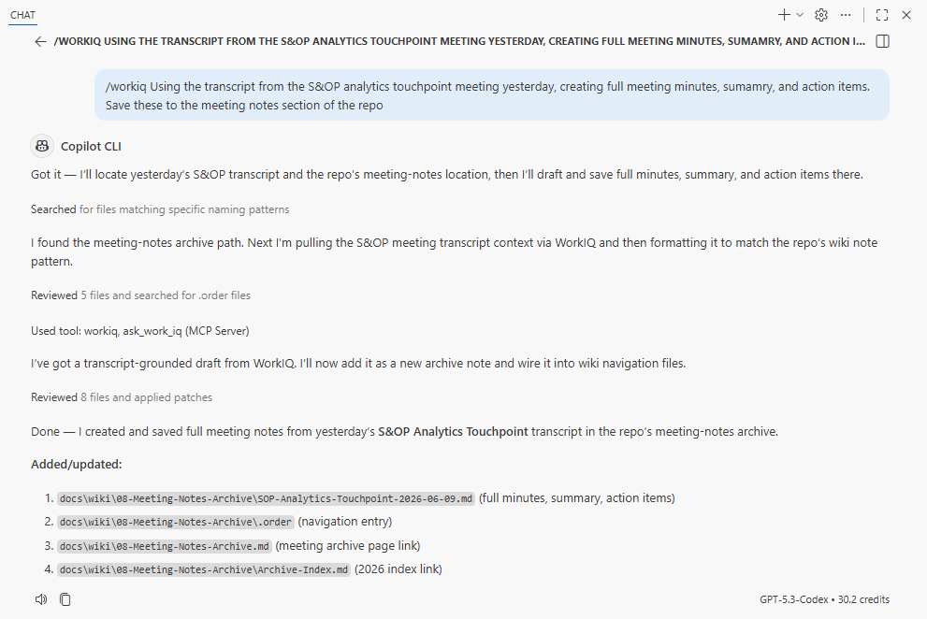

Slide 37
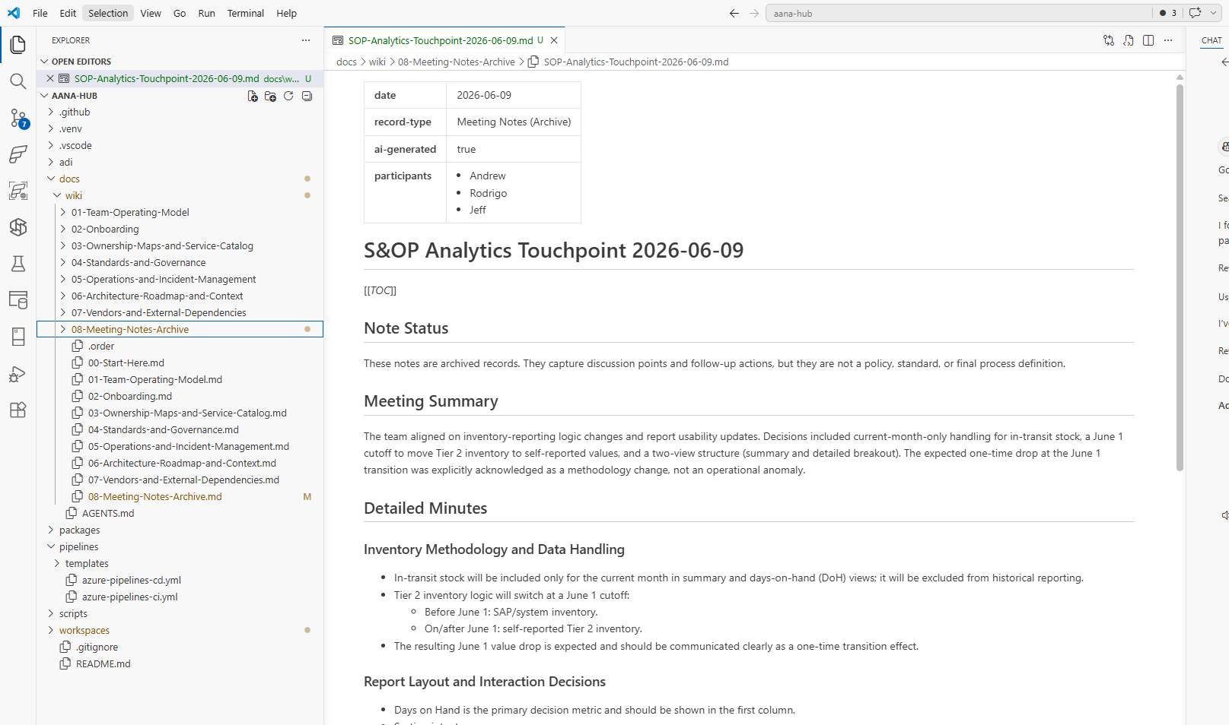

Slide 38
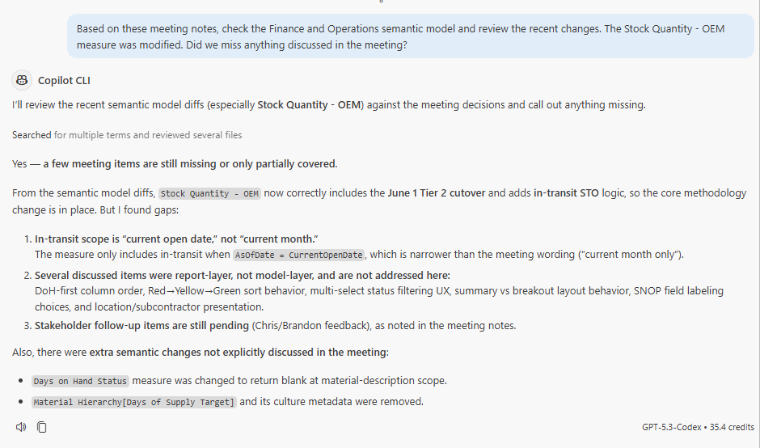

Slide 39
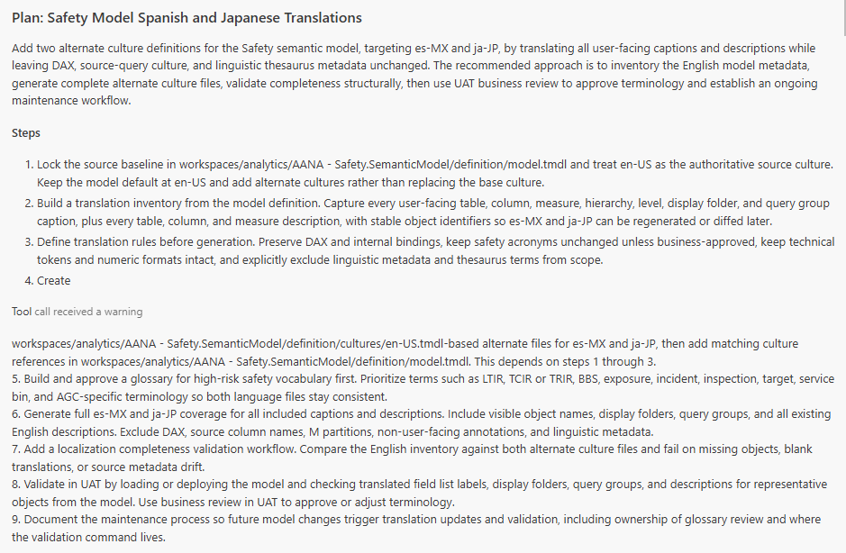
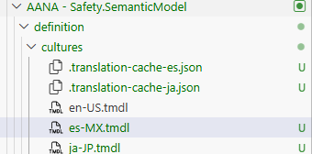
Semantic model translation

Slide 40
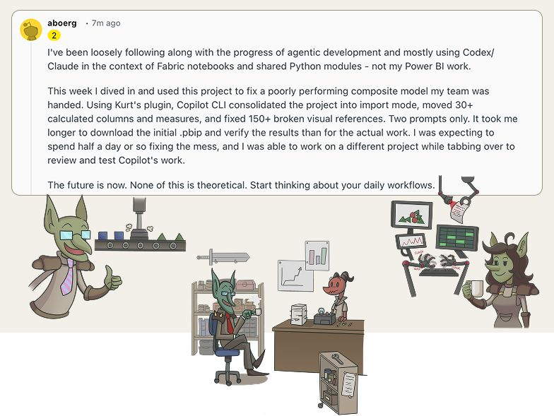
Ownership handover

Slide 41
Thank you.
Questions?

